Slide 1

SIMPLIFIED MONITORING MYANMAR - SM² STUDY
Kirby Institute | 2018

Slide 2
PRESENTATION OUTLINE
Part I: SM2 study detail
Study team
Background and rationale
Study design and objectives
Study schema and procedures
Participant identifiers
Research samples and tests
Receiving research samples
HCV fingerstick VL assay
EDTA plasma processing and storage
DBS drying and storage
Data management
Part II: Laboratory detail

Slide 3
Part I: SM2 study detail

Slide 4
1. STUDY TEAM
POSITION | NAME
Australian Investigators | A/Prof Gail Matthews Dr Josh Hanson Prof Greg Dore Dr Tanya Applegate Prof Mark Boyd
Myanmar Investigators | Dr Kyaw Swar Lin Prof Sabai Phyu Dr Pyo Pyae Nyein Prof Mar Mar Kyi Dr Ne Myo Aung Dr Myint Myint Yee

Slide 5
2. BACKGROUND & RATIONALE
Low cost highly effective DAAs are now available in Myanmar
Simplification of diagnostic methodology is still required
Rapid point-of-care tests provide an opportunity to increase linkage to care
Current HCV RNA testing in Myanmar is centralised using venepuncture plasma
Locally collected finger-stick HCV POC and/or Dried Blood Spots (DBS) could reduce turn around time, drop outs and the number of required visits.

Slide 6
3. STUDY DESIGN
Phase IV
Open-label
Non-randomised
Multi-centre
HCV “Test and Treat”
5-8 participant expected per month
200 is target recruitment number

Slide 7
HYPOTHESES
Simplified virological and safety monitoring during and following DAA therapy is an effective and safe management strategy in a resource limited setting
Novel diagnostic methods for HCV detection including DBS collection and fingerstick capillary HCV RNA testing (GeneXpert, Cepheid) will perform in an equivalent manner to standard plasma HCV RNA methodology

Slide 8
PRIMARY OBJECTIVE
To evaluate the proportion of patients with undetectable HCV RNA at 12 weeks post-treatment (SVR12) following a course of DAA therapy delivered using a simplified schedule of safety and virological monitoring.

Slide 9
SECONDARY OBJECTIVE
To evaluate concordance between HCV RNA detection pre- and post- therapy using finger-stick HCV RNA POC testing (Xpert® HCV Viral Load, Cepheid) versus standard plasma HCV RNA detection
To evaluate acceptability and feasibility of finger stick and DBS collection in a LMIC setting
To evaluate concordance pre- and post- therapy between HCV core antigen (DBS) and standard plasma HCV RNA detection
To evaluate concordance pre and post therapy between HCV RNA (DBS) and standard plasma HCV RNA detection
To enhance and develop laboratory and research capacity at Specialist Hospital Mingaladon (SHM), Specialist Hospital Waibargi (SHW) and Insein General Hospital (IGH).

Slide 10
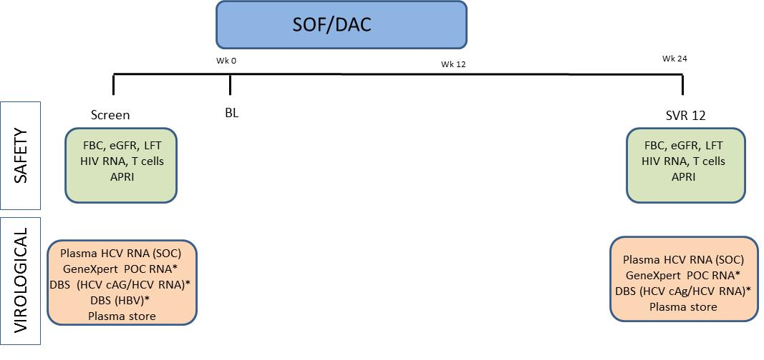
4. STUDY SCHEMA

Slide 11
VISIT SCHEDULE & ASSESSMENTS
HCV Ab Test
Done routinely in HIV infected patients
HCV RNA
Local HCV RNA, CBC and Biochem
Research HCV RNA point-of-care test – capillary blood received and tested at MARCH labs
Treatment
Commence Treatment (HCV RNA positive only)
SVR12
Research HCV POC and DBS
Plasma
Questionnaire
Research DBS and EDTA whole blood – processed and stored at MARCH labs

Slide 12
5. STUDY PROCEDURES - Visit #1: Screening
In addition to the Standard of Care* (SOC) tests the following research assessments must be done:
LABORATORY – RESEARCH SAMPLES
HCV RNA (POC) | Xpert® HCV Viral Load Fingerstick point-of-care assay
EDTA Plasma | 5mL whole blood, with plasma separated and aliquoted for -70 storage
DBS | Dried Blood Spot sample collection
QUESTIONNAIRES
Behavioural questionnaire | Demographics, knowledge risk behaviours (in Myanmar language)
*SOC tests: Liver function tests/ Full blood count/ eGFR, HIV RNA/ CD4 count, HCV-RNA testing (NHL) (Xpert®)

Slide 13
STUDY PROCEDURES - Visit #2: SVR12
In addition to the Standard of Care* (SOC) tests the following research assessments must be done:
LABORATORY – RESEARCH SAMPLES
HCV RNA (POC) | Xpert® HCV Viral Load Fingerstick point-of-care assay
DBS | 5mL whole blood, with plasma separated and aliquoted for -70 storage
EDTA Plasma | Dried Blood Spot sample collection
*SOC tests: Liver function tests/ Full blood count/ eGFR, HIV RNA/ CD4 count, HCV-RNA testing (NHL) (Xpert®)

Slide 14
STUDY SITES & TIMELINES
Tasks | 2018 |  | 2019 |  |  |  | 2020 |  |  |  | 2021
 | Q3 | Q4 | Q1 | Q2 | Q3 | Q4 | Q1 | Q2 | Q3 | Q4 | Q1 | Q2
Ethics Approvals
Site training & laboratory
Recruitment Period
Follow-up Period
Study Close
24 month recruitment period

Slide 15
Part II: Laboratory detail

Slide 16
5. PARTICIPANT IDENTIFIERS
Participants must be identified using three data items on all study data, samples and essential documents. All sample labels will be completed by the site prior to samples arriving at UM2.
 | SCR to SVR12
Participant ID | 1803 - __ __ __ __ __ (Site ID, 5 digits) - __ __ __ (3 digits)
DOB* | dd/mmm/yyyy
2x2 Initials* | __ __ - __ __ (first two letters of last name – first two letters of first name) e.g. Josh Hanson (HA-JO)
Site IDs:
    1. Mingaladon - 95101
    2. Waibargi - 95102

Slide 17
6. RESEARCH SAMPLES AND TESTS
The following tests are required as part of the study protocol:
Test | Visit
 | Screening (All) | Treatment Start | SVR12
Fingerstick GeneXpert HCV RNA point-of-care test (CBCT) | X |  | X
5ml Blood in 10mL EDTA | X |  | X
Dried blood spot sample | X |  | X
Standard of care safety bloods | X |  | X
National laboratory GeneXpert HCV RNA | X |  | X
Research samples are in yellow

Slide 18

VISIT #1: SCREENING
Three research samples collected at site
Research samples processed and tested or stored at UM2
Courier samples
to UM2
(<3pm)
Informed consent |  | Capillary blood CT EDTA whole blood DBS Safety bloods SOC HCV RNA |  | Participant completes Screening Questionnaire in Kobo (Form 1A) |  |  |  | GeneXpert HCV VL EDTA Plasma store DBS score, dry and store
If the participant is HCV RNA Negative
  - The participant has completed the study
If the participant is HCV RNA Positive
  - The participant will return for a second visit to commence treatment.

Slide 19
VISIT #2: SVR12
Research samples collected at site
Research sample processing and testing or storage
Capillary blood EDTA whole blood DBS SOC HCV RNA |  |  |  | GeneXpert HCV VL EDTA Plasma store DBS score, dry and store
Courier sample
to UM2 (<3pm)

Slide 20
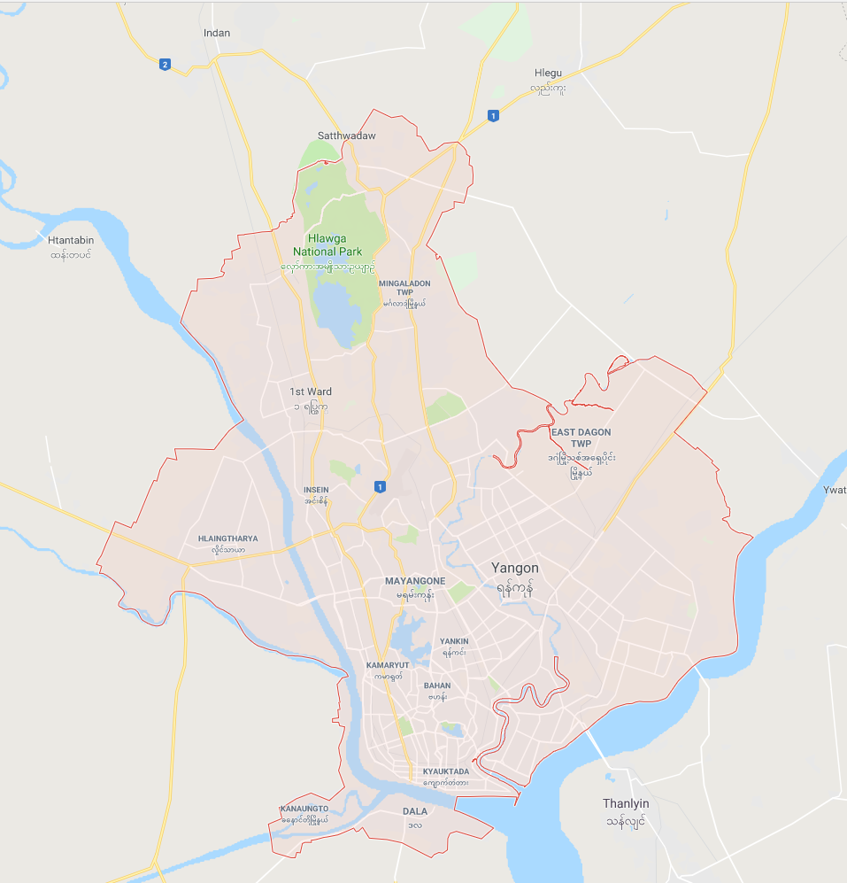
STUDY SITES
Recruitment sites:
Mingaladon
Waibargi
Laboratory:
UM2 MARCH lab
Specialist Hospital Mingaladon
Specialist Hospital Waibargi
University of Medicine 2 (UM2)

Slide 21
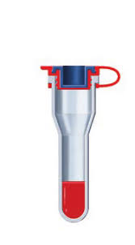
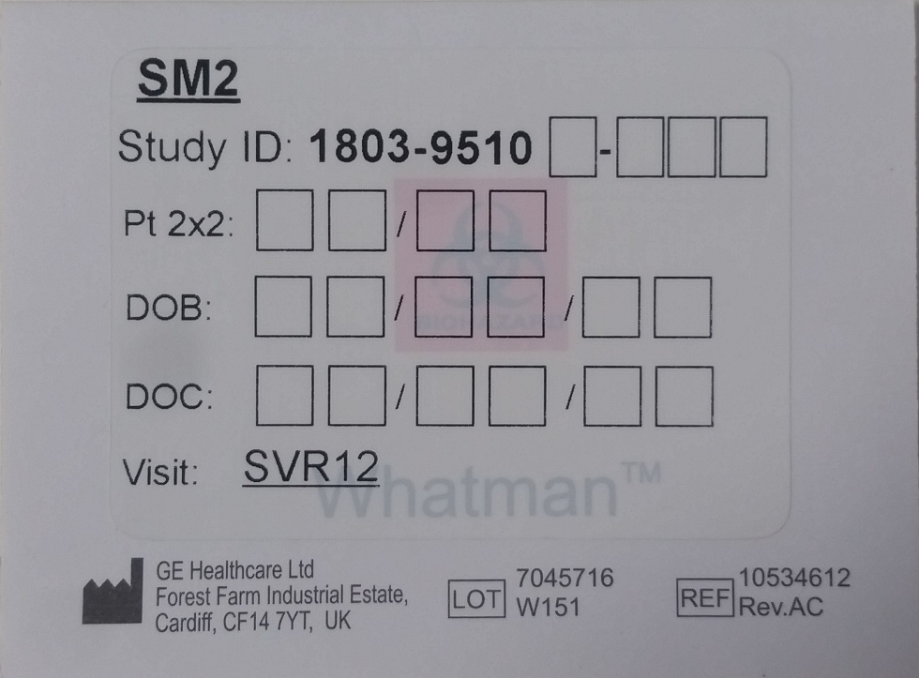
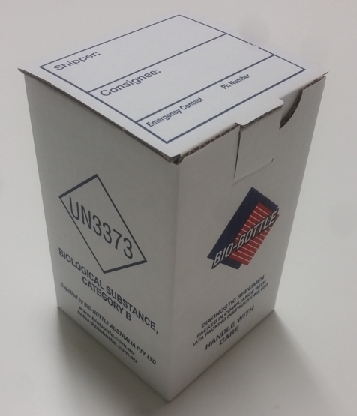
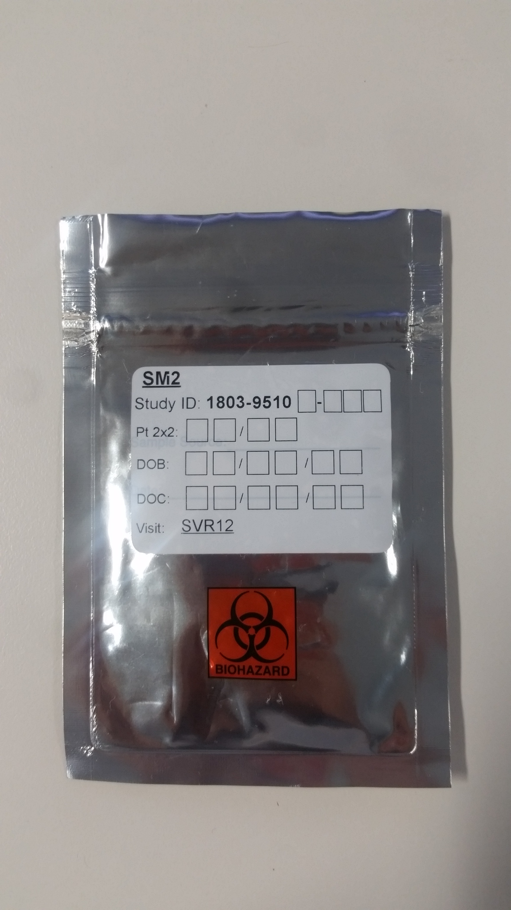

7. RECEIVING RESEARCH SAMPLES
RESEARCH SAMPLES WILL ARRIVE LIKE THIS
+
DBS card
EDTA plasma
CBCT
All of the samples will be labelled at site before being sent to UM2

Slide 22
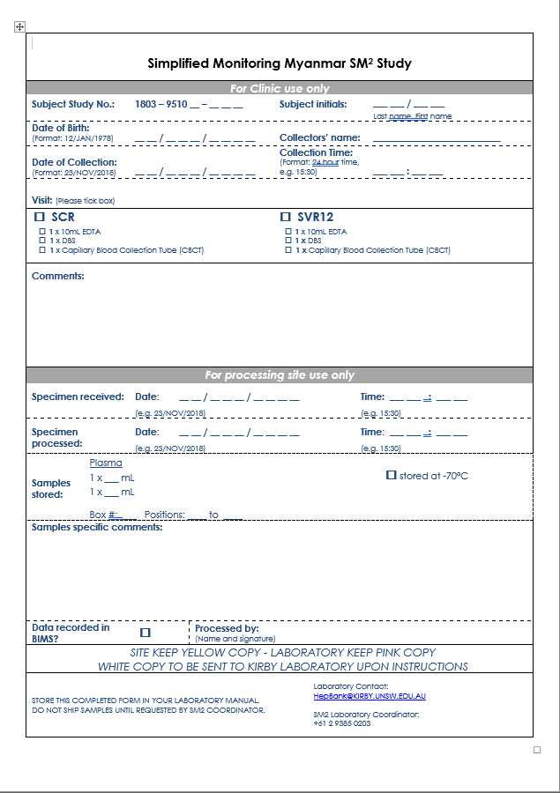
LABORATORY REQUEST FORM – SAMPLE RECEIPT
Research samples will arrive with a Laboratory request form. The top half will have been filled in by the clinic.
The UM2 Lab will complete the bottom half (for processing site only) once samples are received.
Ie.
Specimen received
Specimen processed
The plasma volume stored per cryovial.
Note. Data will be recorded in LabKey (while BIMS is in development)

Slide 23
8. HCV VL FINGERSTICK ASSAY
Training video for collection through to loading onto Xpert
Part I. Fingerstick sample collection (completed at site) into CBCT and DBS
Part II. Loading capillary blood into Xpert HCV fingerstick cartridge (this part is completed at UM2 labs).
Collecting, transporting and testing samples

Slide 24
HOW TO TEST CAPILLARY BLOOD HCV RNA
Guide to performing minivette fingerstick blood collection Myanmar SM2 v1.0

Slide 25
8. HCV VL FINGERSTICK assay
Typical Workflow
The typical workflow for processing a specimen sample using the GeneXpert IV
Overview of the Step Task Section
Start the GeneXpert Dx System
  Perform Database Management Tasks.
  Checking available assay definitions and importing assay definitions
  Prepare the assay-specific GeneXpert cartridge
Create a test
Load the cartridge and start the test
Monitor the test progress
View the test results
Generate test reports
Export test reports

Slide 26
i. Starting the GeneXpert and Database management
Power on the instrument before switching on the laptop. the software GeneXpert DX should start-up automatically.
When the login dialog box appears enter the username and password cphd to start.
The home screen will be displayed as shown.
The database management dialog box will pop up.
If Yes is clicked a further dialog box will display database management options.
If No is clicked in the database Management dialog box it will close and only the home screen will be displayed.

Slide 27
Checking assay definitions
Before starting an in-vitro diagnostic test check that the assay definition you want to use is already installed in the software
In the GeneXpert DX system window click Define Assays. The define assays window will open.
2. In the assay list ( left side of the
window verify that the assay
definition you want is present
The assay definition file for the current HCV viral load fingerstick batch should be;
HCV VL WB RUO_3.gxa
If the assay is not listed the assay definition file must be imported

Slide 28
Importing Assay Definitions
To import a new assay definition
1. In the GeneXpert DX system window
click define assays as before. The define
assays window will open.
2. Click Import on the lower right hand side
of the window.
3. The Import assay dialog box will open as
show
4. Locate and select the assay definition file
HCV VL WB RUO_3.gxa from the USB
or other location.
5. The new assay name and version
number will appear in the assay list on
the left hand side of the assay definition
screen

Slide 29
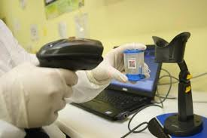
ii. Creating a test
In the GeneXpert DX system window click Create Test.
The sample ID barcode dialog box will appear
Scan the sample ID using the supplied barcode scanner.
The scan cartridge barcode dialog box will appear. Scan the Barcode on the cartridge

Slide 30
iii. Load cartridge and start the test
Once the cartridge barcode has been scanned
The software automatically fills the required
Information in the create test window (as shown)
Optional: In the select module window the module for loading the cartridge will be displayed this can be changed if required by the user.
Pick up the cartridge by its body and not the reaction tube.
Open the module door and place the cartridge on the module bay floor. The label should face out and should be positioned at the heel of the bay.
Click start and a green light will flash over the module selected.
Close the module door all the way and hold it shut with the finger till the door locks and the green light stops flashing and stays on.

Slide 31
iv. Monitor the test progress
The test progress can be monitored in the modules section on the left hand side of the check status window
Which displays the progress or phase of the test and the amount of time remaining till the end of the test.
The right hand side shows test since launch. Which means tests since the most current start of the GeneXpert DX system.
This shows all tests that have completed including tests with error or invalid results.

Slide 32
v. View test results
In the GeneXpert Dx System window click View Results on the menu bar
To find the exact test for which you would like to view results click the view test button on the bottom of the screen
Select the test of interest from the list and click OK
The test results will be displayed as shown
The Patient ID, sample ID,
Assay name, version and test result will be visible under the Test Result tab

Slide 33
vi. Generate test report
To generate a PDF file containing test results, in the view results window click Report.
Select the test / tests you would like to generate results for.
Click generate report file
You can then save this file in a default location or a location you specify.
Alternatively click on Preview PDF to view the results of the tests selected then print results or save to a given location.

Slide 34
vii. Export test reports
To export the test result to a comma separated value (.csv) file in the view results window click Export
When the result export dialog window appears as shown locate and select the folder to which you want to export the file.
Type a file name and click save.

Slide 35
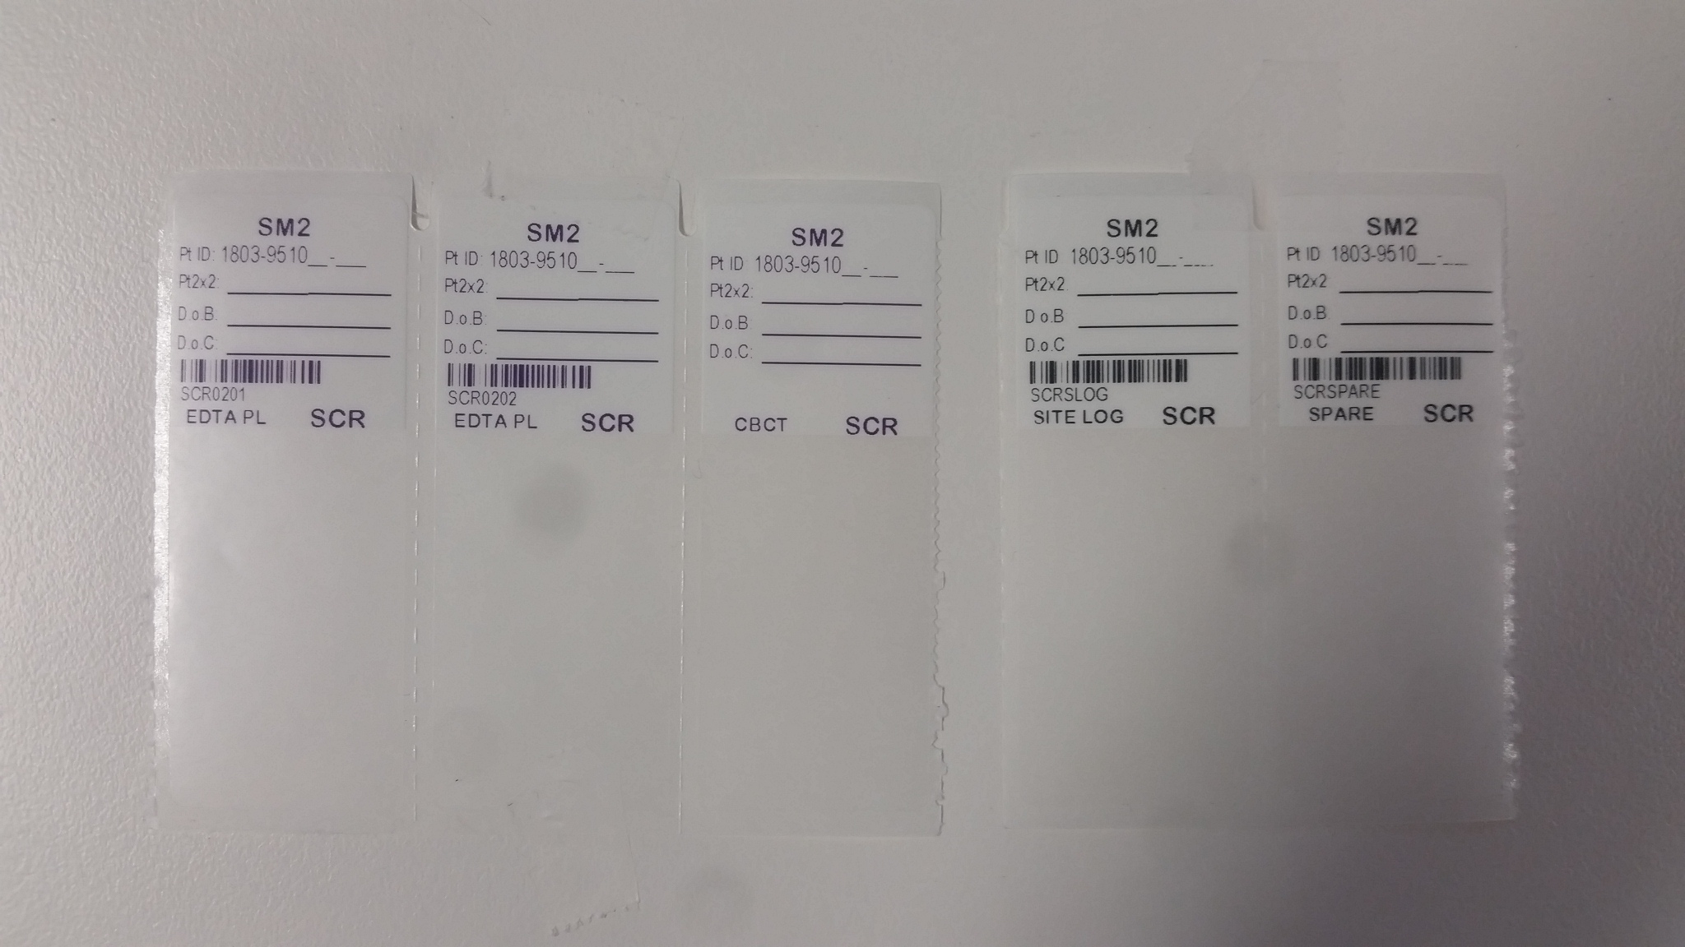
9. EDTA PROCESSING and ALIQUOT LABELS
5ml EDTA whole blood will be spun and plasma aliquoted into 2 cryovials.
These labels will arrive already completed
Please use these to label 2x cryovials to store plasma aliquots

Slide 36



EDTA PROCESING AND STORING
PROCESSING INSTRUCTION: EDTA Plasma
1 x 10mL EDTA tube (containing only 5ml whole blood)
Centrifuge at 1800 x g for 20 minutes. Note if tube is underfilled prepare vials in 1ml-aliquots as possible.
NOTE: Store whole blood at 2-25ºC for no longer than 6 hours before processing. If a delay has occurred and the sample is >6 hrs old still process the sample but ensure the delay is clearly recorded on the lab request form in case the subsequent HCV RNA result is questioned as being erroneous.
(2) Aliquot plasma into two round bottom internal thread cryovials using sterile pipettes.
Place each aliquot label that has been
supplied onto each cryovial with labels supplied.
(3) Store at –70ºC or below
in 10 x 10 plastic cryobox labeled:
SM2
EDTA PLASMA
BOX # _______

Slide 37
10. DBS DRYING and STORAGE
Each DBS sample card will arrive in a sealed foil zip lock bag.
The DBS card will have been already scored at the site, so this is not required at the MARCH lab.
The DBS cards will need to be re-dried overnight to ensure humidity does not affect the cardboard.
The DBS samples will be tested in bulk at the end of the study.
We will review which DBS samples are eligible for testing, and by what method at that time.

Slide 38
HOW TO DRY DBS CARDS at UM2 MARCH labs
 | All DBS cards arriving at MARCH labs will be re-dried Assemble DBS drying rack in a fume cupboard or Biosafety cabinet to minimise dust. Remove the DBS card from the foil bag. Tuck the flap under the filter paper to assist drying and place on the drying rack. Allow the DBS to air dry overnight inside the hood The DBS sample will change from bright red to dark red/brown as it dries.
Avoid touching or smearing the blood spots Allow the specimen to fully air dry at room temp Keep away from direct sunlight or an open window Do not heat, stack or allow DBS to touch other surfaces while drying
DBS card drying rack

Slide 39

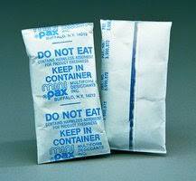
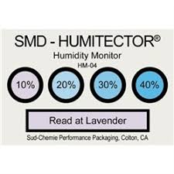
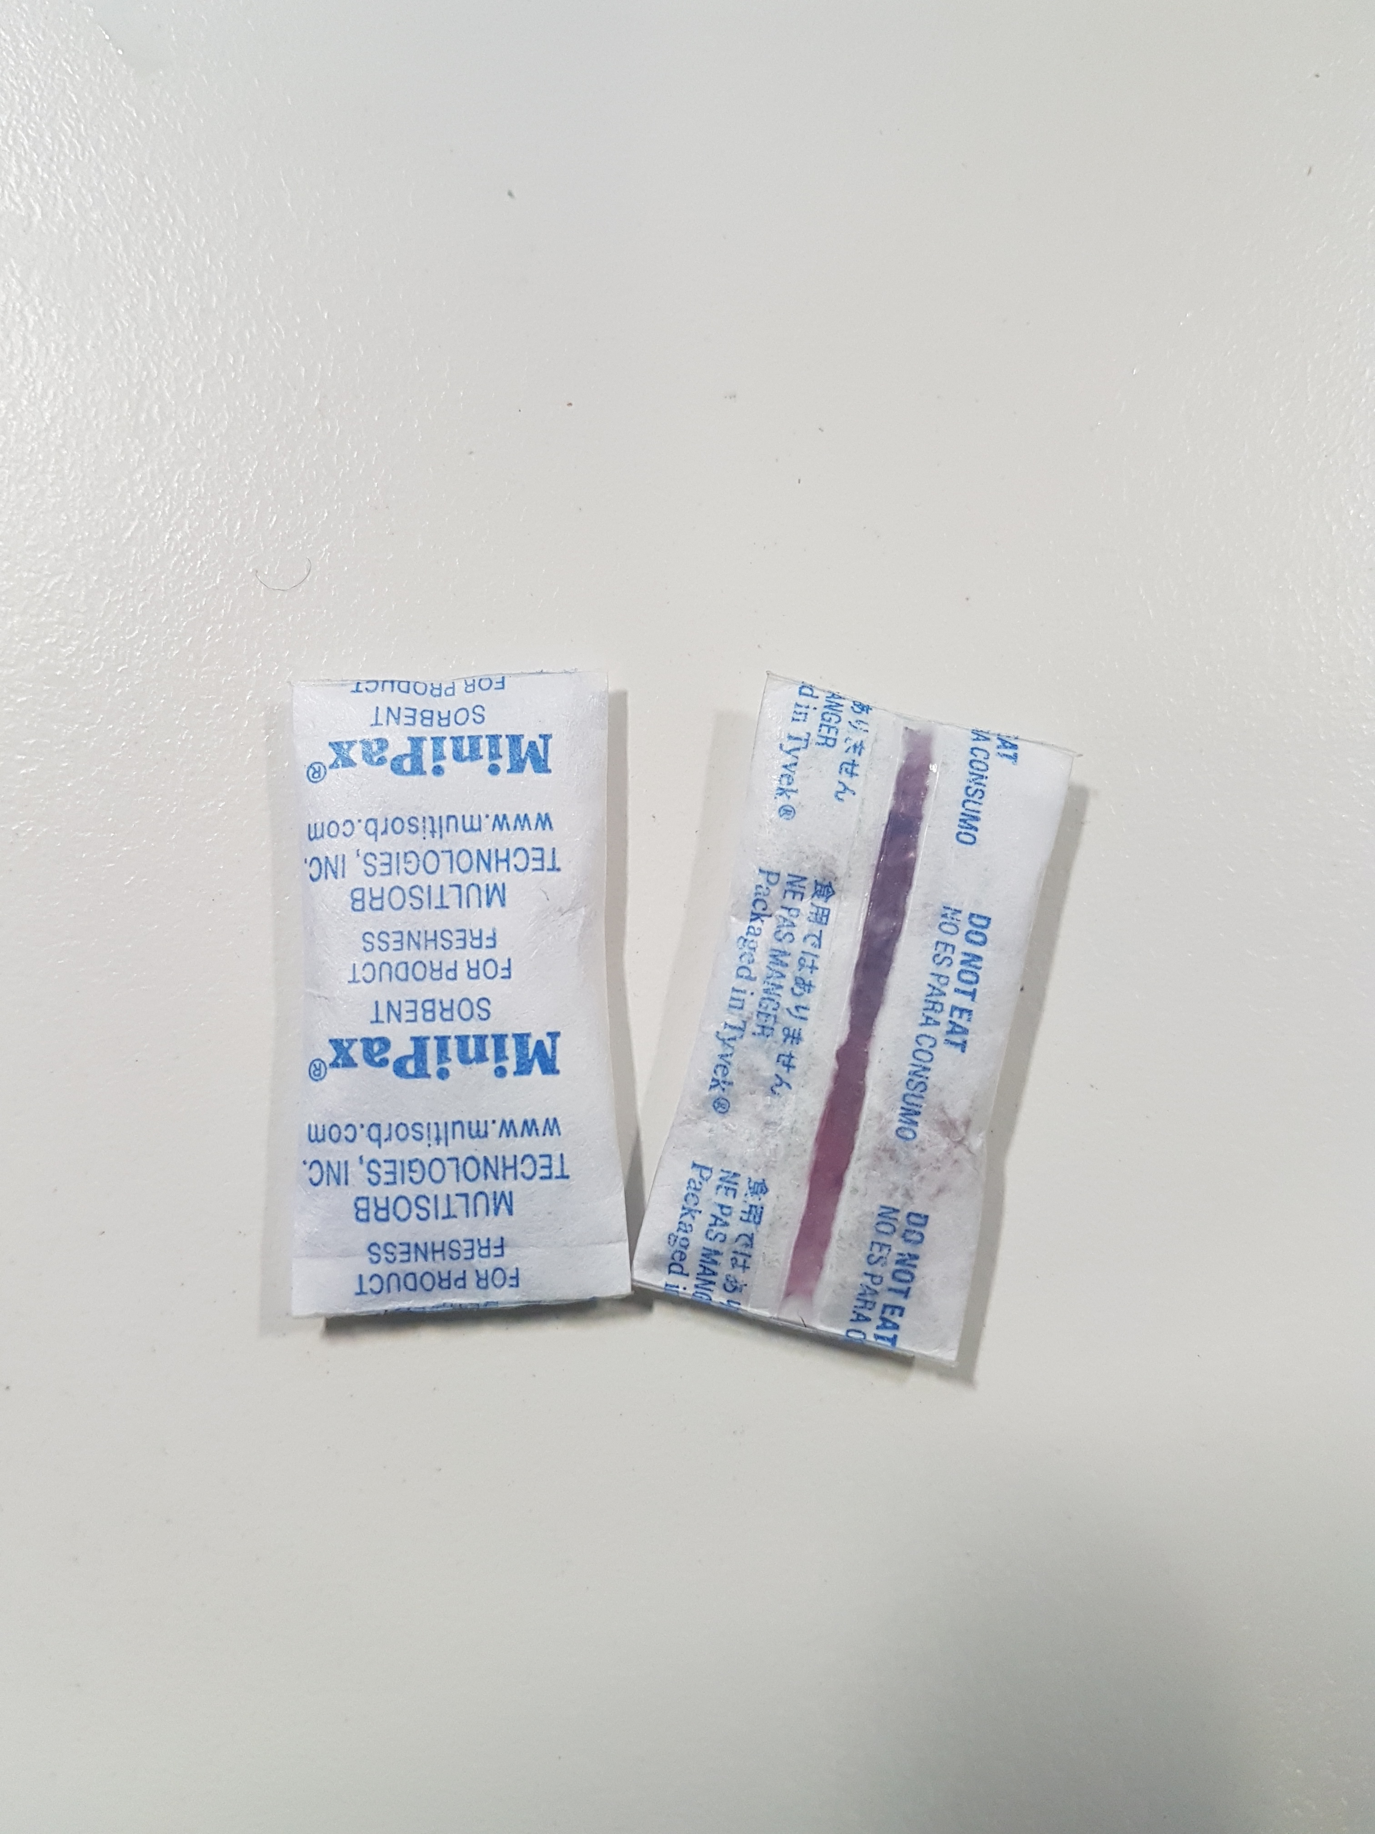
Packing of DBS Cards for long-term storage
Assessment of humidity indicator and desiccant packs
Assess the humidity by examining the indicator card and desiccant packs and if both show blue coloured indicators:
- repack the dry DBS card in foil bag with the same indicator and desiccant packs = Humidity score 1
If the humidity indicator shows pink at even 10% humidity but the adsorbent packs are still blue:
- replace both the humidity indicator and desiccant packs with new items from the supplied consumables = Humidity score 2
If the humidity indicator shows pink at even 10% humidity and the adsorbent packs are also pink:
- replace both the humidity indicator and desiccant packs with new items from the supplied consumables.
= Humidity score 3

Slide 40
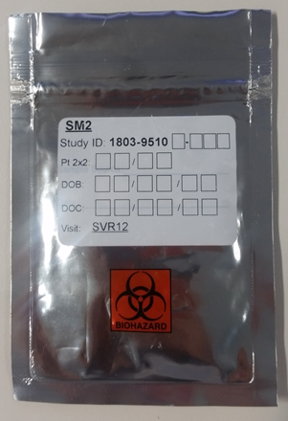
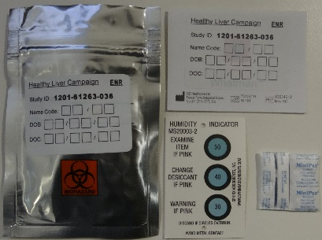
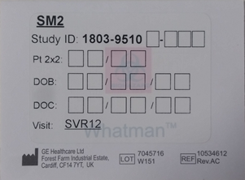
Packing of DBS Cards, indicators and desiccants for storage
Close flap on DBS card, insert into a sealable foil bag then add humidity indicator card + two absorbent packs.
Apply pressure to ensure air is expelled from foil bag prior to sealing.
Place foil bag inside sealed plastic container in minus 80 freezer (or -35 if unavailable).
(If container is not suitable, just bundle DBS into a larger, sealable plastic bag before placing in freezer)

Slide 41
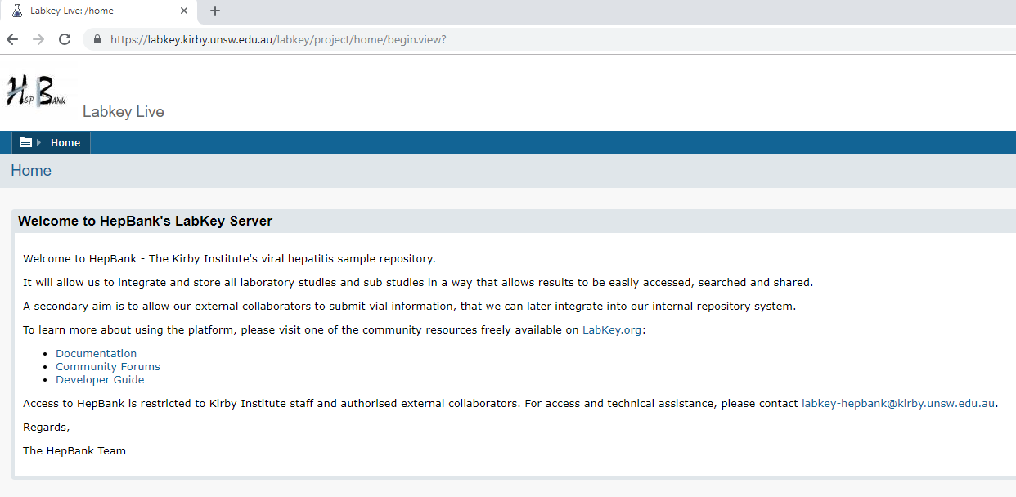
11. DATA ENTRY INTO LABKEY OFF-SITE REPOSITORY
LabKey is an online off-site repository (OSR) that we use to save all collected sample information.
This allows us to track and store EDTA and DBS information which can be easily accessed, searched and shared.
Below is a video on how to use LabKey and enter sample data.
Video Link:
https://kirby.unsw.edu.au/sites/default/files/_local_upload/others/LabKey_OSR%20Training_Aug2017.mp4

